Slide 1
Pokerbots 2022
Lecture 1: Introduction to Pokerbots
Notes:
Welcome!

Slide 2
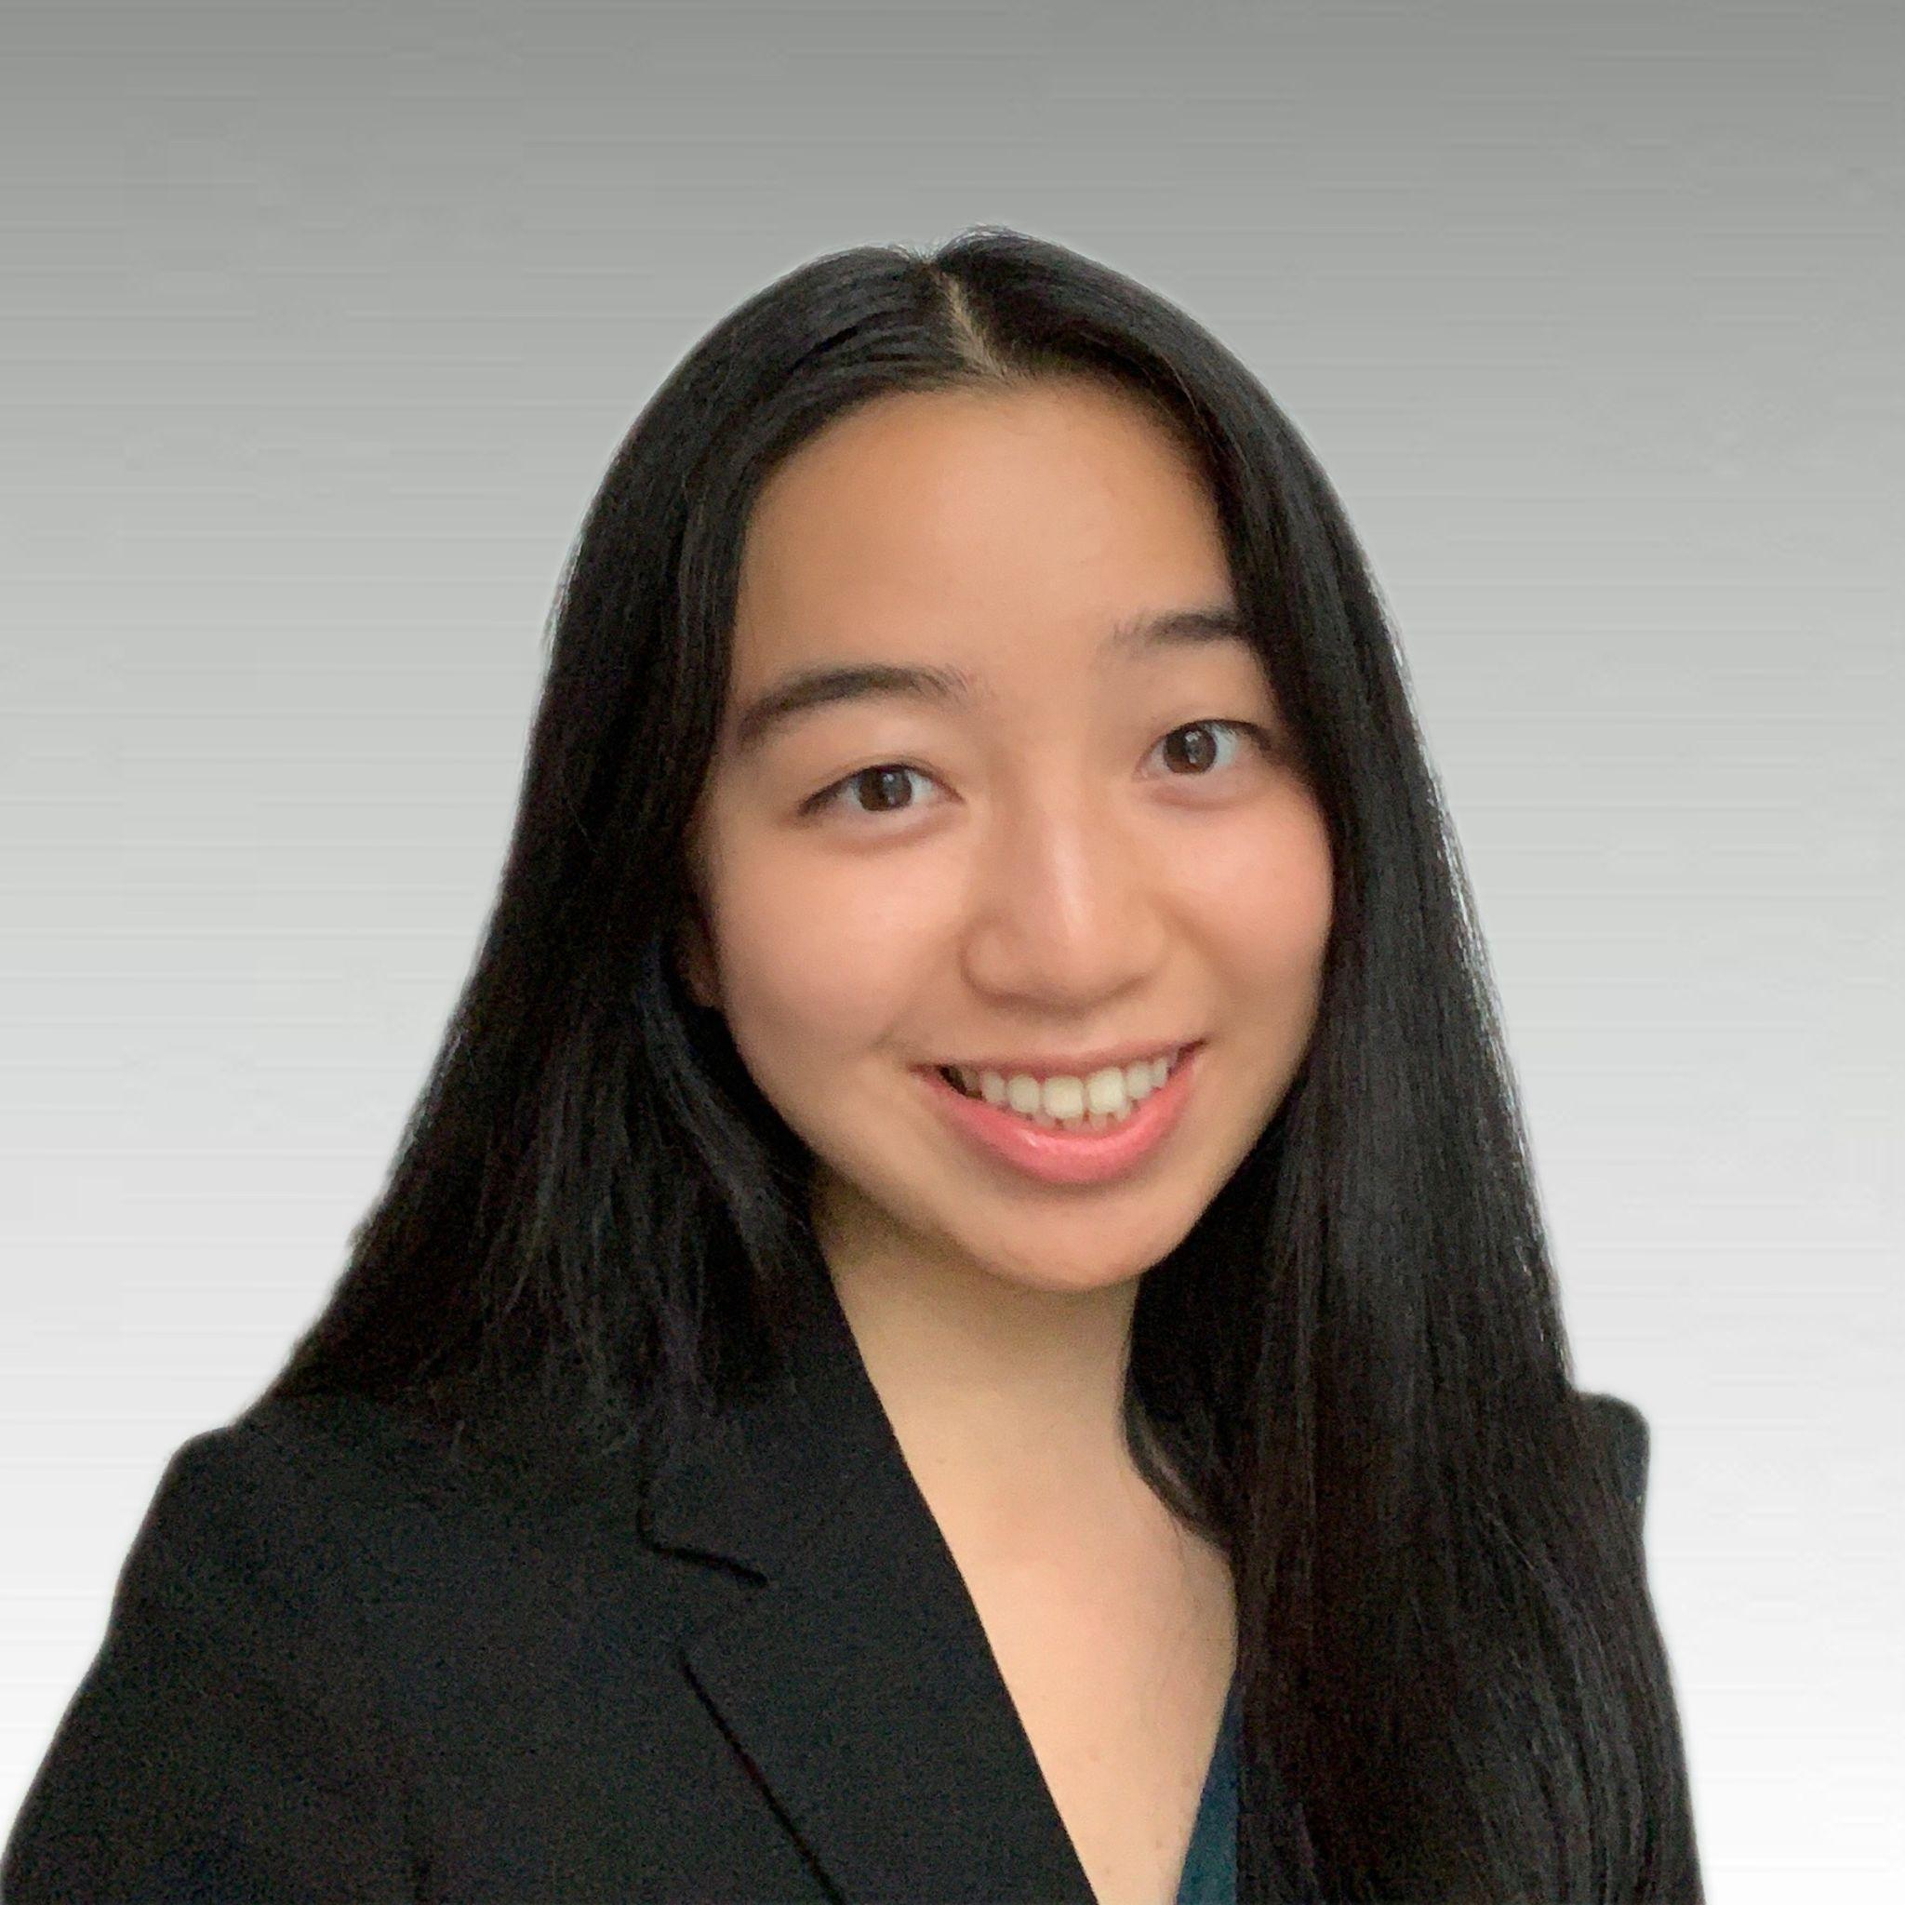
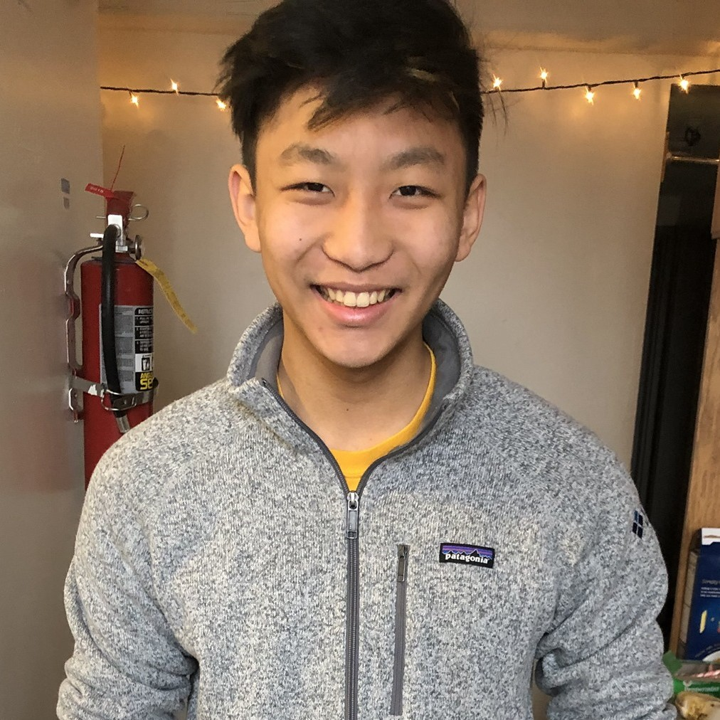
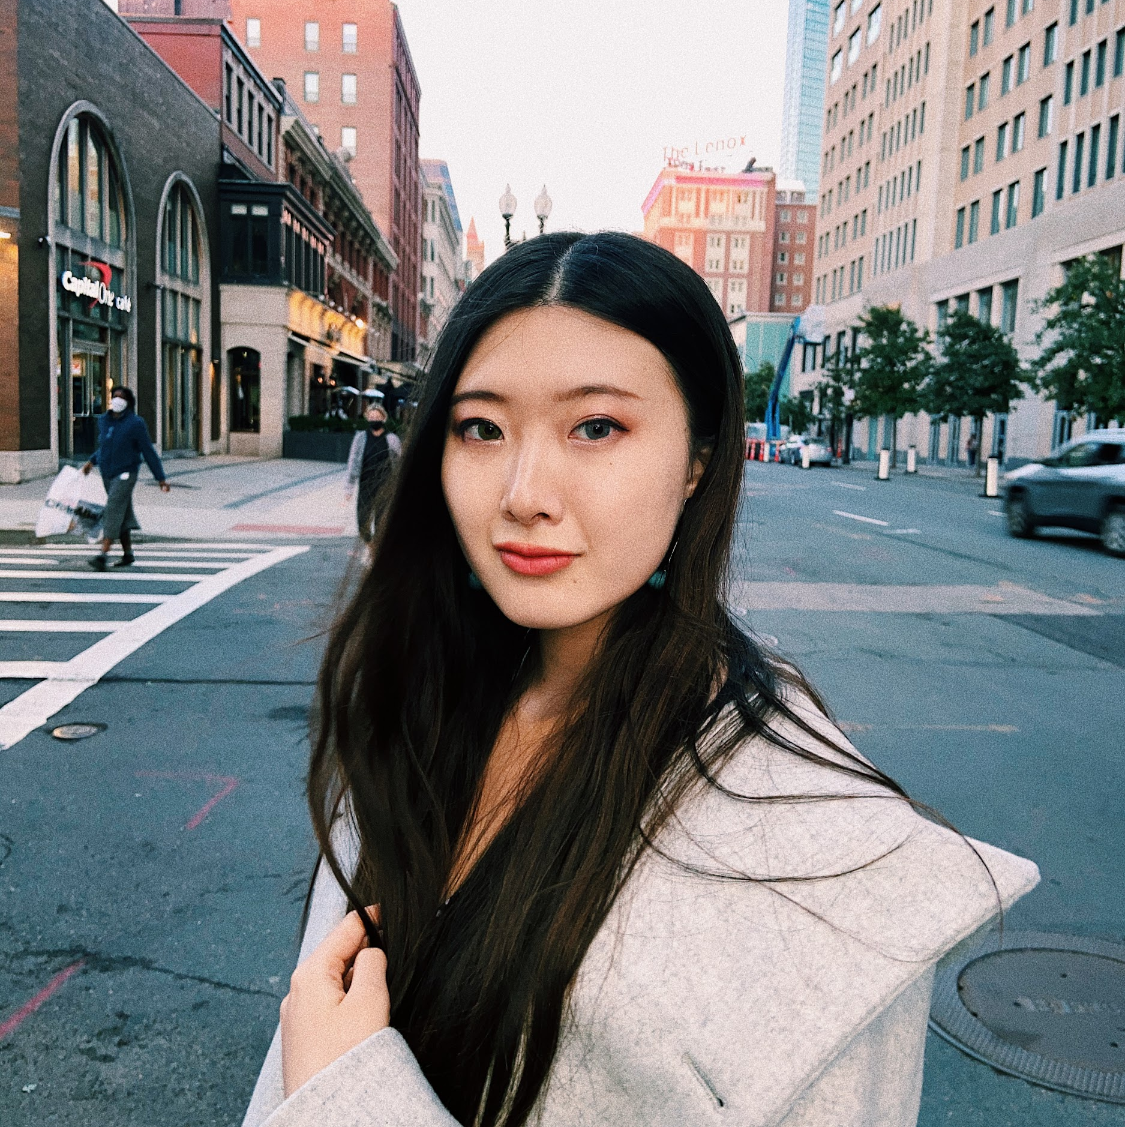
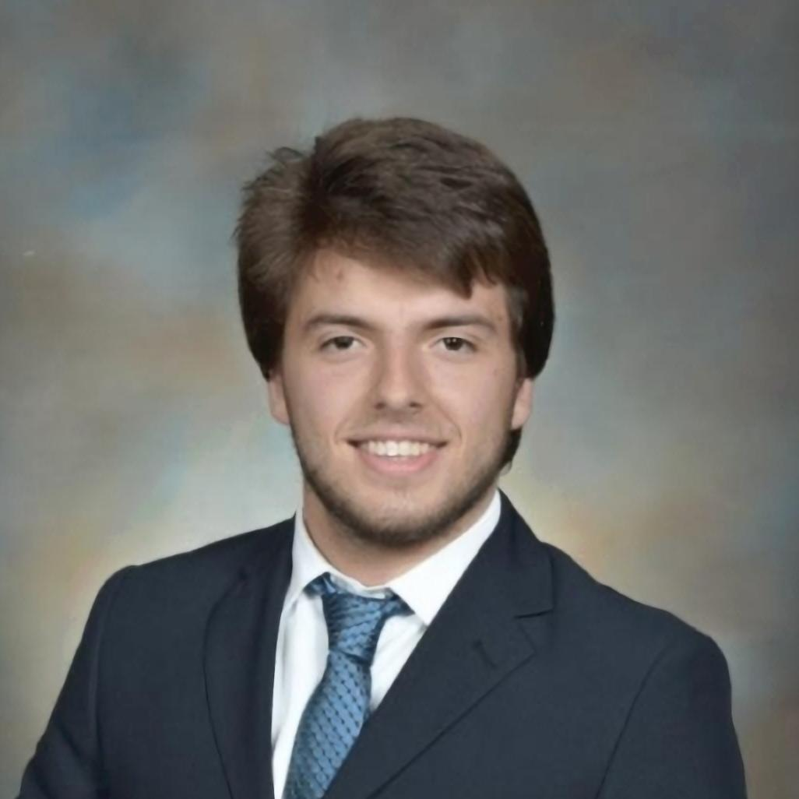
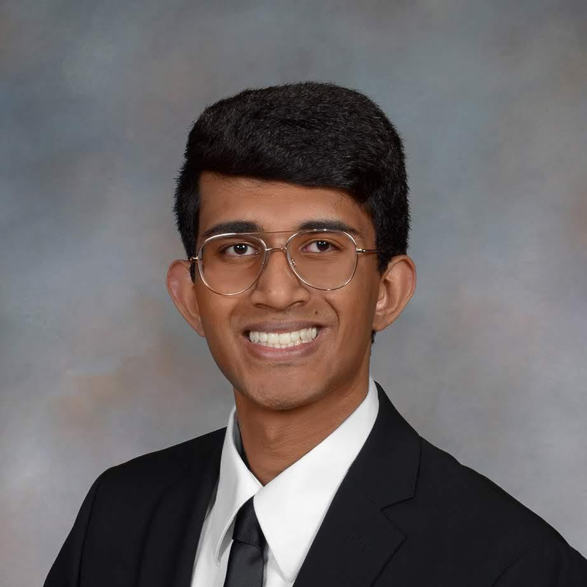
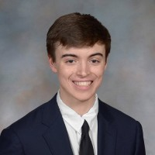
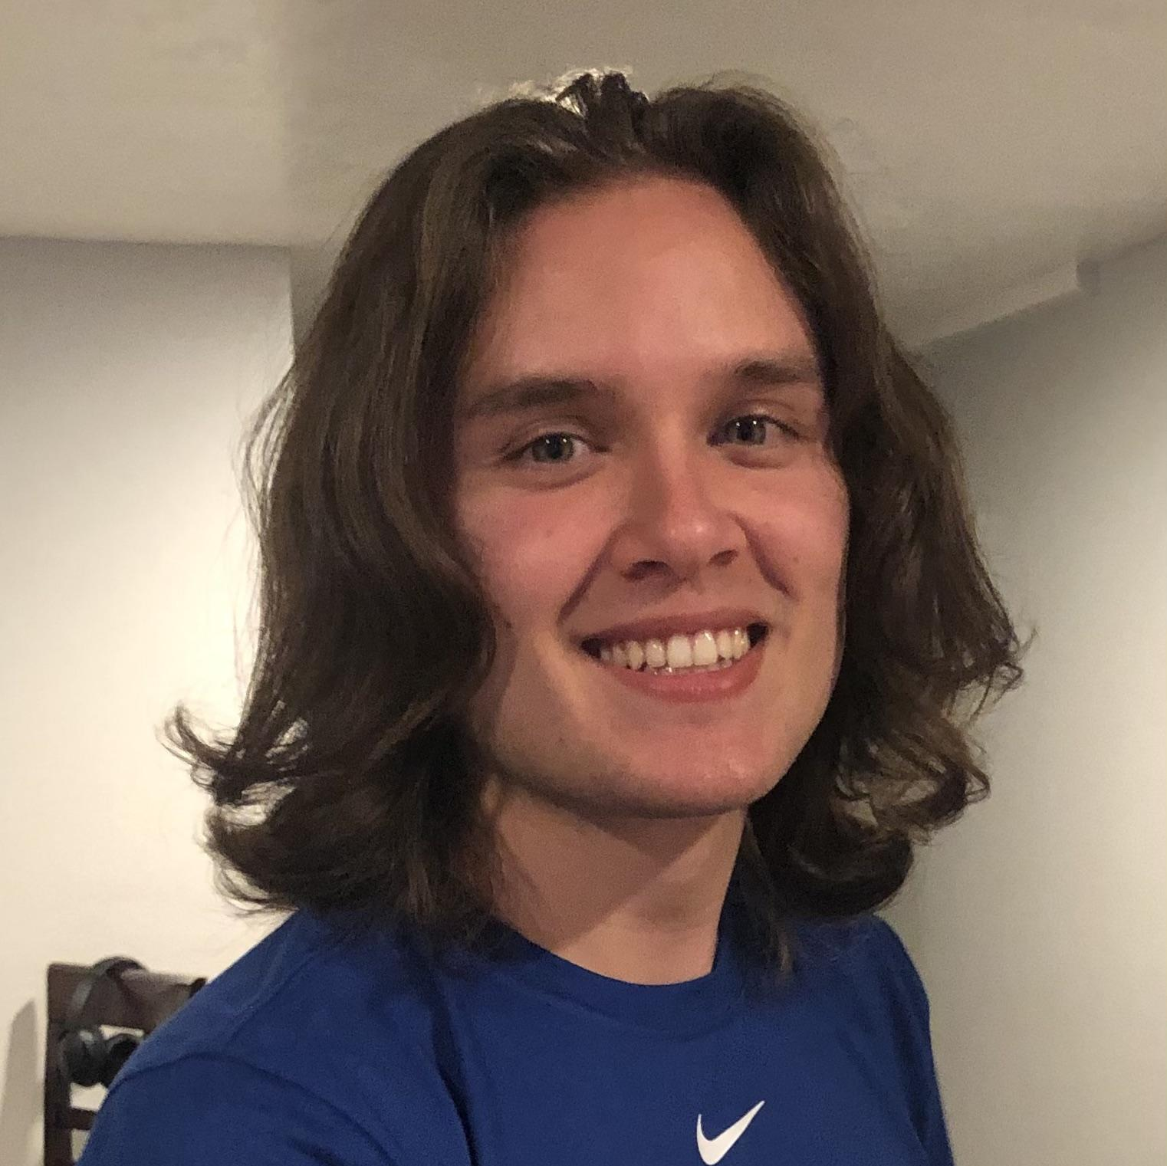
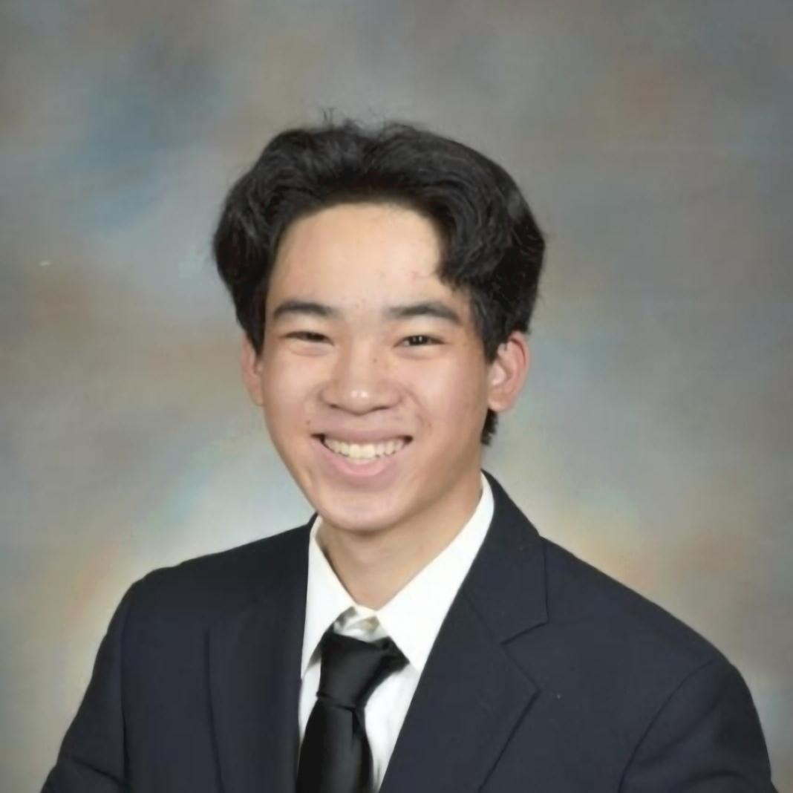
Meet the team
Notes:
Andy
---

Slide 3











Sponsored by multiple top quantitative finance firms, Pokerbots is also a great opportunity for networking and landing jobs or internships!
pkr.bot/drop
Notes:
Shreyas
---
imc=silver
sig=gold
hrt=platinum
Jane st = gold
Citadel = gold
Optiver = plat
Drw = gold or plat fornow put gold

Slide 4
Resume:
pkr.bot/drop
Notes:
Airpods!!!

Slide 5
Giveaway

Slide 6
Giveaway Game:
pkr.bot/distance
Notes:
Average of the distance from home to MIT of pkr team

Slide 7
Agenda
Class overview + logistical details
Intro to poker + variant rules
Skeleton bot setup and connecting to the scrimmage server
Testing your bot locally
Overview of skeleton bot architecture
Coding Lecture 1 reference bot

Slide 8
Class Overview + Logistical Details

Slide 9
Class Structure
Six lectures,in person (6-120), MWF 1 to 2:30pm EST
Office hours, virtual, MWF 2:30 to 3:30pm EST, TR 1 to 2pm EST
Scrimmage server (first three weeks)
Weekly tournaments
Final tournament and event (Jan 28th)

Slide 10
>$35k
Total Prize Amount

Slide 11
Prizes
Grand prize: $5k
2nd - 5th place : $4k, $3k, $2k, $1k
Bot Language Specific Prizes
~$2.5k/week Scrimmage Server Prizes
All announced prizes can be viewed on the syllabus
More prizes to be announced soon!
Notes:
The other prizes will be announced later; some prizes will not be announced until after they have been awarded.
4th and 5th
Language bots - set a minimum of where they're placing
Scrimmage server prizes
Longest time at top of scrimmage server
Top 3 on scrimmage

Slide 12
6 Lecture Titles
Introduction to Pokerbots
Poker Theory
Game Theory
Engineering and Performance
Advanced Topics
Guest Lecture: Noam Brown
Notes:
Talk about target audiences for the six classes (more beginner for the first one, second one is beginner if you know poker. Will have live coding in classes 1+2. All slides will be released and all lectures will be recorded and made available on the pokerbots website) Also talk about class objectives briefly for each one.

Slide 13
How to Receive Credit For This Course
Participate
Improve
Report
Submit a bot to the scrimmage server every week
Each week you should beat your bot from the previous week
Submit a 3-5 page strategy report at the end of the competition
Notes:
Strategy report 3-5 pages; miss a week -> submit a make up, 0.5 pages double spaced, simple explantion of what you tried to do that didn’t work

Slide 14
Intro to Poker + Variant Rules

Slide 15
Heads-up No-limit Hold’em Poker Rules
Objective: earn as many chips as possible
Players receive two secret cards (hole cards)
Players bet into a pot in several rounds; the pot is given to the player with the best poker hand
Structure of a betting round: first player can bet 0 (check) or any amount between “big blind” and the # of chips they have remaining. If they check, action passes to second player. If they bet, second player can fold, call, or raise
Hand strength is determined as the best 5-card poker hand you can form out of 7 cards: 2 hole cards and 5 community cards
Notes:
one of the most famous card games in the world

Slide 16
Poker Rules
Two cards dealt to each player (hole cards)
Betting round (first betting round begins with blinds)
Flop (3 community cards revealed)
Betting round
Turn (+1 community cards revealed [4 total])
Betting round
River (+1 community cards revealed [5 total])
Betting round
Settlement (showdown)

Slide 17
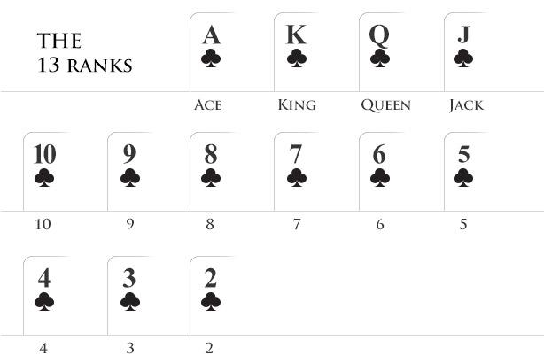

Card Rankings
Notes:
https://www.wsop.com/poker-hands/

Slide 18
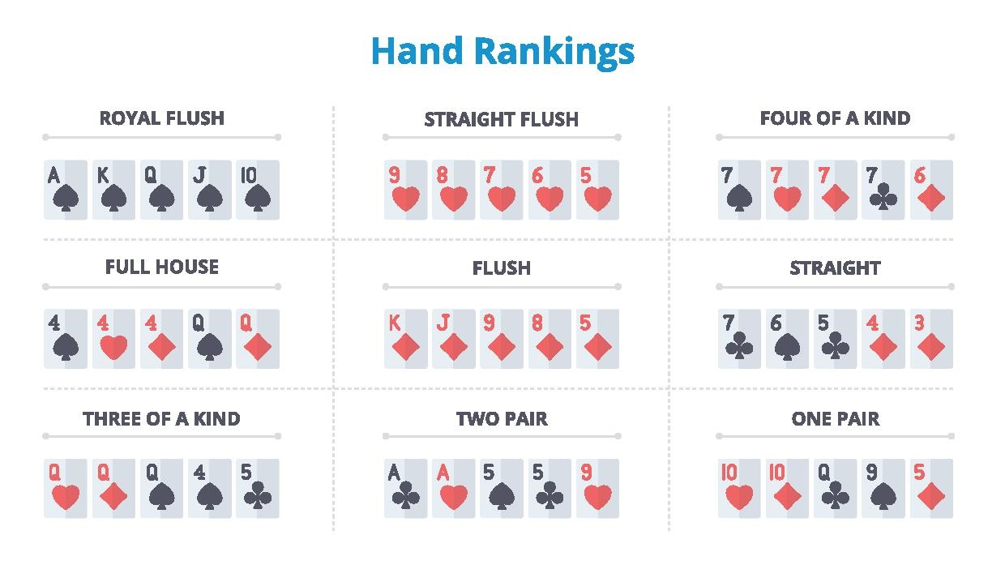
Poker Hand Strength

Slide 19
2022 Variant Reveal

Slide 20
2022 Variant - Swap Hold’em
On the flop and turn, there's a chance one of your hole cards is randomly swapped with one from the deck
10% on the flop, 5% chance on the turn (subject to change later in the tournament)
Each card is evaluated independently, meaning there's a chance both cards are swapped
Goal: When your cards are swapped, navigate how to still make good decisions and maximize your bankroll

Slide 21
Skeleton Bot Setup: Connecting to the Scrimmage Server

Slide 22
Before You Code
See Piazza post @8 to set up your development environment for Pokerbots
Once finished, make a GitHub account to facilitate code management
Read up on using Git from the command line

Slide 23
Getting Set Up
Clone engine from mitpokerbots/engine-2022; create new repository for your code
Scrimmage server: download ZIP file from GitHub website and upload it directly.

Slide 24
Testing Your Bot Locally

Slide 25
Engine Config Parameters
Pull the engine from github.com repository mitpokerbots/engine-2022
config.py parameters: number of hands, number of seconds, where to bots

Slide 26
Overview of Skeleton Bot Architecture

Slide 27
Skeleton Bot Structure
Engine info
GameState, RoundState, and BoardState classes
Bot walkthrough

Slide 28
Coding reference-lecture-1 bot

Slide 29
Example Bot
We want to place our strongest cards strategically
We want to raise the stakes if we are holding good cards
Eventual goal: use a more advanced method to choose our hole cards combined with more sophisticated betting logic

Slide 30
Giveaway Winner

Slide 31
Average Distance Game:
1104.25 miles
Notes:
Guess the average height of the PKR team
Sony Headphones

